Slide 1

Major Project Presentation: Deep Fake Video Detection
Group No 1 :
Vedant Chaudhari
Rupesh Darpe
Rajaram Desai
Salil Gujar
UNDER THE GUIDANCE OF:
Prof. Jaychand Upadhyay
Copyright @Information Technology Dept , XIE

Slide 2
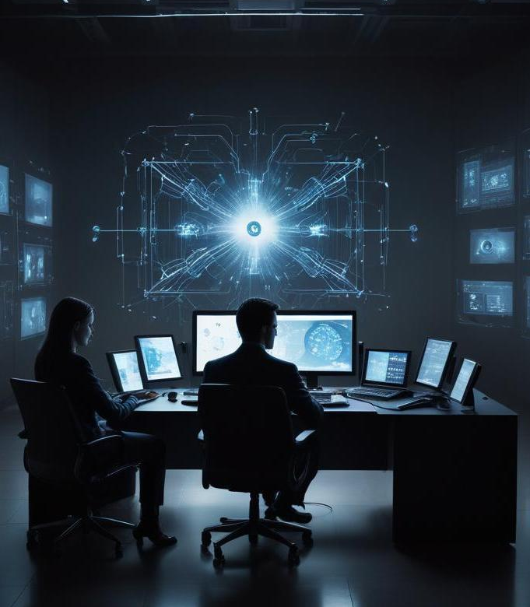
Introduction
The popularity of AI is on the rise.
Despite its versatility, the misuse of AI has also become a rampant problem.
Deep fake images and videos for false agenda is one of them.
Averting such a massive atrocity is a need of the hour
Copyright @Information Technology Dept , XIE

Slide 3
Objectives
Detect AI generated videos made with deepfakes and face swapping
Develop a website for the easy access of the detection feature
Implement multiple algorithms for detecting the authenticity of a user inputted video.
Copyright @Information Technology Dept , XIE

Slide 4
Literature Survey
Sr.No | Publication Year | Title | Author | Observations
1 | 2023 | Deepfake Attacks: Generation, Detection, Datasets, Challenges, and Research Directions | Amal Naitali, Mohammed Ridouani, Fatima Salahdine, Naima Kaabouch | The article offers a comprehensive overview of deepfakes, covering generation and detection techniques, existing datasets, challenges, future research directions, and the societal issues of misinformation and reputational damage, while emphasizing the urgent need for improved detection methods in light of advancements in generative AI.
2 | 2022 | Deepfake Detection: A Systematic Literature Review | MD Shohel Rana, Mohammad Nur Nobi, Beddhu Murali, Andrew H. Sung | Deep learning-based methods, particularly CNNs, are predominant in deepfake detection research, with detection accuracy as the primary performance metric. These techniques typically surpass non-deep learning models in efficacy, and the FF++ dataset is the most commonly utilized resource in studies.
3 | 2021 | Deepfakes Classification of Faces Using Convolutional Neural Networks | Jatin Sharma, Sahil Sharma, Vijay Kumar, Hany S. Hussein, Hammam Alshazly | The proposed model achieved accuracies of 53.25%, and 88.63% on the three benchmark datasets. The ensemble model significantly improved performance, achieving accuracies 75.79% on the same datasets. The results indicate that the proposed models outperform existing models in deepfake detection
Copyright @Information Technology Dept , XIE

Slide 5
Sr.No | Publication Year | Title | Author | Observations
4 | 2023 | A Novel Smart Deepfake Video Detection System | Marwa Elpeltagy, Aya Ismail, Kamal Eldahshan | This paper provides a strong foundation for developing an advanced deepfake detection system by leveraging multimodal analysis, deep learning, and temporal feature extraction techniques. By implementing the XceptionNet and InceptionResNetV2 models, incorporating GRU-based attention mechanisms, and fusing video and audio features, your project can achieve high detection accuracy and outperform traditional methods.
5 | 2022 | A contemporary survey on deepfake detection: Datasets, algorithms, and challenges. | Gong, L.Y. and Li, X.J. | The survey by Gong and Li has classified deepfake detection methods as conventional CNN-based detection, CNN with semi supervised detection, transformer-based detection, and biological signal detection. The survey compares deepfake detection datasets and methodologies, highlighting their pros and cons. The authors discuss the challenges of obtaining accurate findings across datasets and suggest future directions to increase detection reliability
Copyright @Information Technology Dept , XIE

Slide 6

Problem Statement
With the rapid advancement of deep learning techniques, deepfake videos have emerged as a significant threat to digital security, misinformation, and identity theft. These manipulated videos are becoming increasingly sophisticated, making it challenging to distinguish between real and fake content. There is an urgent need for an efficient and user-friendly solution to detect deepfake videos accurately.
Copyright @Information Technology Dept , XIE

Slide 7
Proposed Methodology
Dataset: Used FaceForensics++, which contains real and manipulated videos (Deepfakes, Face2Face, FaceSwap, NeuralTextures).
Preprocessing: Extracted frames using OpenCV, detected facial landmarks with Dlib, and applied noise reduction techniques.
Models Used:
[1]MesoInceptionNet – Detects deepfake patterns efficiently.
[2]XceptionNet – Deep CNN model for image classification.
[3]ResNet – Handles complex facial anomalies.
Training: Trained model with various real time videos, and evaluated the accuracy, precision, recall, and F1 score.
Deployment: Developed a Django-based web app where users upload videos for deepfake detection.
Future Enhancements:
[1]Expand dataset with real-world deepfakes.
[2]Optimize the web application for scalability and efficiency.
Copyright @Information Technology Dept , XIE

Slide 8
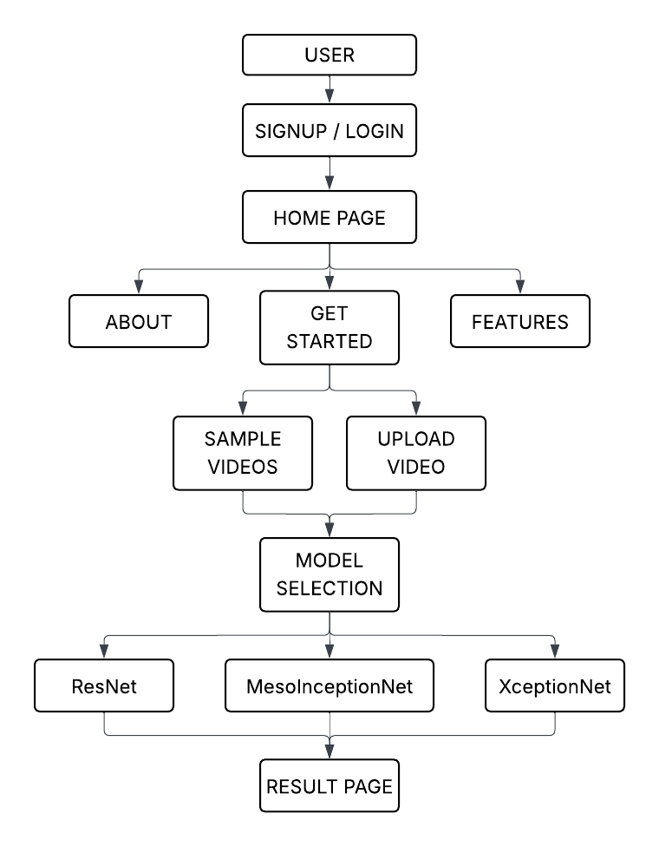
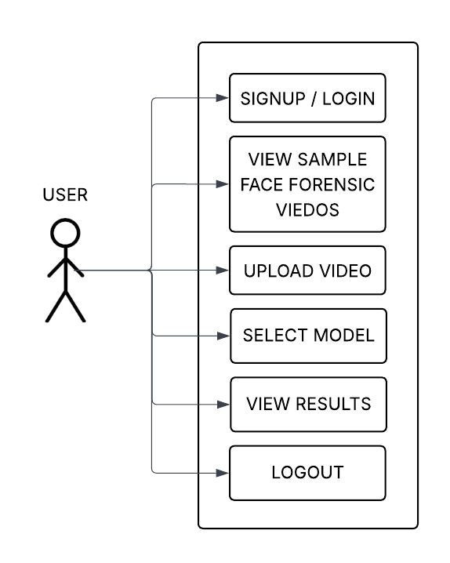
Proposed System
Fig 1: Flow Diagram
Fig 2: Use case diagram
Copyright @Information Technology Dept , XIE

Slide 9
Modern Tools
Sr no. | Name | Functionality
1 | Pytorch | It will be used to create, train, and test deep learning models.
2 | Dlib & OpenCV | Extracting the frames containing the face of the subject.
3 | Pillow | Loading and storing the required frames for feeding them into the model
4 | Django | Web-based deployment of the model
5 | Sqlite db | Management of the authentication and the django server.
Copyright @Information Technology Dept , XIE

Slide 10
Requirements Analysis
Sr. no. | Name | Need
1 | Video Upload Functionality | The user can choose a video of their liking for detection.
2 | Frame Extractor | The existing frames in the raw video need to be properly extracted and separated for detection.
3 | Deepfake Detection Model | The extracted frames are to be operated upon by our deep learning model which was trained on a suitable dataset.
4 | Intuitive UI | The results thus obtained need to be displayed in a format that is user friendly.
5 | Login/Signup Functionality | The user can safely upload their videos and view only their own results.
Copyright @Information Technology Dept , XIE

Slide 11
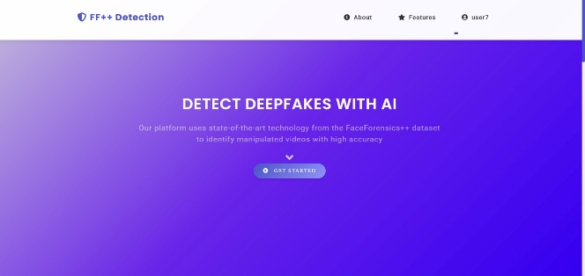
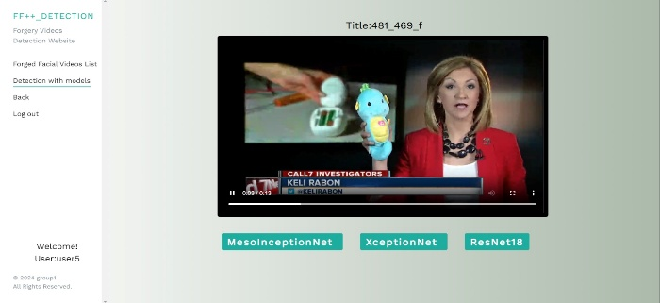
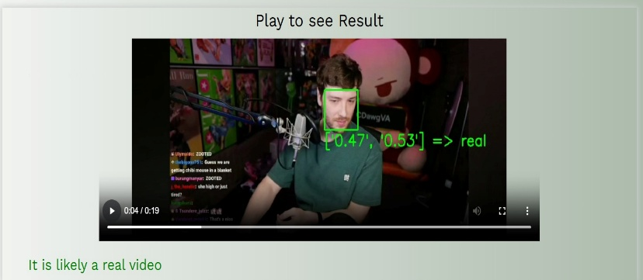
Results
Image 1: UI Home Page
Image 2: Model Selection page Page
Image 3: Sample output
Copyright @Information Technology Dept , XIE

Slide 12
Conclusions
The development of a deepfake detection system is imperative in today's digital landscape where misinformation poses significant risks. By employing advanced algorithms and a user-friendly web application, we can provide effective tools to detect and mitigate the threats from deepfake videos. Continuous study and adaptation to technological advancements will be essential in maintaining robust defenses against manipulation in visual media.
Copyright @Information Technology Dept , XIE

Slide 13
Reference
[1] Amal N., Mohammed R., Fatima S., Naima K., “Deepfake Attacks: Generation, Detection, Datasets, Challenges, and Research Directions,” Computers, October 2023, 12 (216), 1–26. Available at: https://doi.org/10.3390/computers12100216.
[2] Andreas R., Davide C., Luisa V., Christian R., Justus T., Matthias N., “FaceForensics++: Learning to Detect Manipulated Facial Images,” ICCV, 2019, 1 (1), 1–8.
[3] Jatin Sharma, Sahil Sharma, Vijay Kumar, Hany S. Hussein, Hammam Alshazly, “Deepfakes Classification of Faces Using Convolutional Neural Networks,” Traitement du Signal, June 2022, 39 (3), 1027–1037, Available at: https://doi.org/10.18280/ts.390330 .
[4] Marwa Elpeltagy, Aya Ismail, Mervat S. Zaki, Kamal Eldahshan, “A Novel Smart Deepfake Video Detection System,” International Journal of Advanced Computer Science and Applications (IJACSA), January 2023, 14 (1), 407–419, Available at: https://doi.org/10.14569/IJACSA.2023.0140144.
[5] A. Mary and A. Edison, ”Deep fake detection using deep learning techniques: A literature review,” in 2023 International Conference on Control, Communication, and Computing https://doi.org/10.1109/ICCC57789.2023.10164881
[6] A. Robler, D. Cozzolino, L. Verdoliva, C. Riess, J. Thies, and M. Niebner, ”FaceForen sics++: Learning to detect manipulated facial images,” arXiv, vol. 2019, no. 8, pp. 1 12, Aug. 26, 2019.
[7] D. Afchar, V. Nozick, J. Yamagishi, and I. Echizen, ”MesoNet: A compact facial video forgery detection network,” arXiv, vol. 2018, no. 9, pp. 1-11, Sep. 4, 2018. doi: https://doi.org/10.1109/WIFS.2018.8630761
Copyright @Information Technology Dept , XIE

Slide 14
[8]A. Heidari, N. Jafari Navimipour, H. Dag, and M. Unal, ”Deepfake detection using deep learning methods: A systematic and comprehensive review,” WIREs Data Mining Knowl. Dis cov., vol. 13, no. 5, pp. 1-15, Oct. 5, 2023, doi: https://doi.org/10.1002/widm.1520.
[9]Sharma, Jatin, Sahil Sharma, Vijay Kumar, Hany S. Hussein, and Hammam Alshazly. ”Deepfakes Classification of Faces Using Convolutional Neural Networks.” Traitement du Sig nal 39, no. 3 8 Jun 2022, doi: https://doi.org/10.18280/ts.390330
[10] R. Khan, M. Sohail, I. Usman, M. Sandhu, M. Raza, M. A. Yaqub, and A. Liotta, ”Com parative study of deep learning techniques for deepfake video detection,” ICT Express, vol. 10, no. 3, pp. 1-12, Sep. 2024. https://doi.org/10.1016/j.icte.2024.09.018.
[11] H. S. Shad, M. M. Rizvee, N. T. Roza, S. M. Hoq, M. M. Khan, A. Singh, A. Zaguia, and S. Bourouis, “Comparative analysis of deepfake image detection method using convolutional neural network,” Computational Intelligence and Neuroscience, vol. 2021, Art. no. 3111676, pp. 1-18, 2021, doi:https://doi.org/10.1155/2021/3111676.
[12] M. Elpeltagy, A. Ismail, M. S. Zaki, and K. Eldahshan, "A Novel Smart Deepfake Video Detection System," International Journal of Advanced Computer Science and Applications, vol. 14, no. 1, pp. 407-419, 2023, DOI: 10.14569/IJACSA.2023.0140144.
[13] Kaur, A., Noori Hoshyar, A., Saikrishna, V. et al. Deepfake video detection: challenges and opportunities. Artif Intell Rev 57, 159 (2024). https://doi.org/10.1007/s10462-024-10810-6
[14] Nguyen, T.T., Nguyen, Q.V.H., Nguyen, D.T., Nguyen, D.T., Huynh-The, T., Nahavandi, S., Nguyen, T.T., Pham, Q.V. and Nguyen, C.M., 2022. Deep learning for deepfakes creation and detection: A survey. Computer Vision and Image Understanding, 223, p.103525. https
Copyright @Information Technology Dept , XIE

Slide 15
://doi.org/10.1016/j.cviu.2022.103525
[15] Verdoliva, L., 2020. Media forensics and deepfakes: an overview. IEEE journal of selected topics in signal processing, 14(5), pp.910-932. https://doi.org/10.1109/JSTSP.2020.3002101
[16] Gong, L.Y. and Li, X.J., 2024. A contemporary survey on deepfake detection: Datasets, algorithms, and challenges. Electronics, 13(3), p.585. https://doi.org/10.3390/electronics13030585
[17] Yu P, Xia Z, Fei J et al (2021) A survey on deepfake video detection. IET Biom 10(6):607–624. https://doi.org/10.1049/bme2.12031.
[18] Rana MS, Nobi MN, Murali B et al (2022) Deepfake detection: a systematic literature review. IEEE Access. https://doi.org/10.1109/ACCESS.2022.3154404
[19] Patel Y, Tanwar S, Gupta R et al (2023) Deepfake generation and detection: case study and challenges. IEEE Access. https://doi.org/10.1109/ACCESS.2023.3342107
[20] Mitra, A., Mohanty, S.P., Corcoran, P. et al. A Machine Learning Based Approach for Deepfake Detection in Social Media Through Key Video Frame Extraction. SN COMPUT. SCI. 2, 98 (2021). https://doi.org/10.1007/s42979-021-00495-x
[21] Mittal, T., Sinha, R., Swaminathan, V., Collomosse, J. and Manocha, D., 2023. Video manipulations beyond faces: A dataset with human-machine analysis. In Proceedings of the IEEE/CVF winter conference on applications of computer vision (pp. 643-652).
Copyright @Information Technology Dept , XIE

Slide 16
Thank you!
Do you have any questions?
+91 620 421 838

